Slide 1
NODE.JS
(The Backend Of MERN Stack)
Lecture 21

Slide 2
Today’s Agenda
Introduction To Middleware
How Middleware Works ?
Creating A Middleware
Passing Data From Middleware
Running Middleware For Specific Routes/Request
Third Party Middleware
Using Morgan
Using Helmet
Exercises

Slide 3
Introduction to middleware
Express is the most popular web framework for Node.js developers and middleware are the basic building blocks for Express applications.
In fact any Express application is actually a series of middleware function calls.

Slide 4
What is a middleware ?
Middleware in Express are functions that come into play after the server receives the request and before the response is sent to the client.

Slide 5

What is a middleware ?
They are arranged in a chain and are called in sequence.

Slide 6
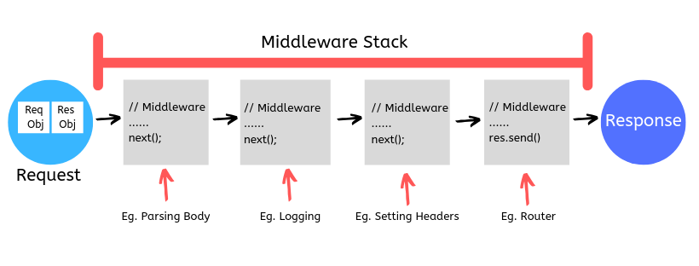
What a middleware has ?
Every middleware function has access to the request, response, and the next middleware function in the application’s request-response cycle.

Slide 7
What a middleware has?
Moreover a middleware can modify the request/response object , pass them to the next middleware function or even terminate the req-response cycle by generating the response

Slide 8
What can a middleware do ?
Due to this a middleware function can perform following tasks:
Authorization
Logging
Error Handling
Rate Limiting
Validation
Any other business logic

Slide 9
How a middleware works ?
To understand the working of a middleware assume a user wants to upload an article at a blogging website.
But before uploading the article the site wants :
To check whether the user is logged in or not .
His account is validated or not.
He is admin or not .

Slide 10
How a middleware works ?
All the above task will be done by 3 middleware functions as follows , after receiving the request:
The first middleware function will check whether user is logged in or not. If not then it will terminate the request-response cycle by generating an error message .
Otherwise it will call next() to transfer the control to next middleware function .

Slide 11
How a middleware works ?
The second middleware function will check whether user’s account is validated or not . If not then it will terminate the request-response cycle by generating an error message .
Otherwise it will call next() to transfer the control to next middleware function .

Slide 12
How a middleware works ?
The third middleware function will check whether user is admin or not. If not then it will terminate the request-response cycle by generating an error message .
Otherwise it will call next() to transfer the control to actual request handler function

Slide 13
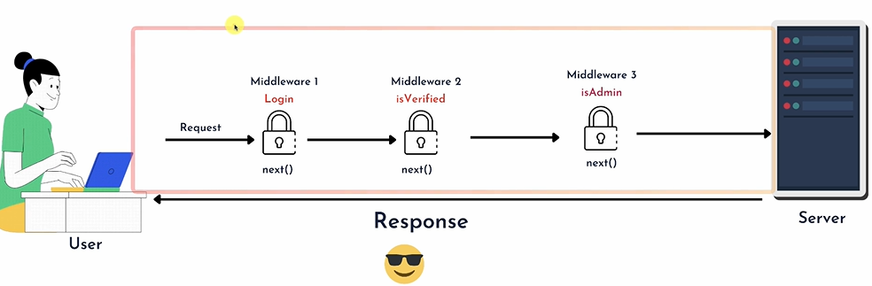
How a middleware works ?

Slide 14
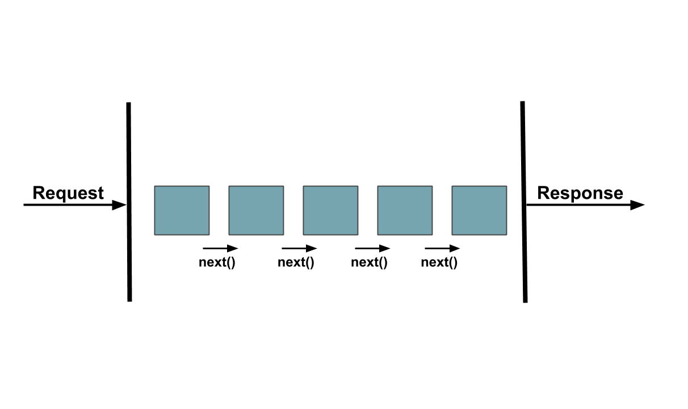
What is next ?
A middleware function typically receives three arguments: req , res and next .
next is the next function which will be executed after the current one.

Slide 15
Special point
If the current middleware function does not end the request-response cycle, it must call next() to pass control to the next middleware function.
Otherwise, the request will be left hanging .

Slide 16
Creating & using middleware
Creating and using a middleware is a 2 step process:
Step 1 : Develop a function with 3 arguments : req, resp and next .
Step 2 : Inform Express to load it as a Middleware .

Slide 17
Step-1:Creating middleware
As discussed a Middleware function is a function with 3 arguments:
request
response
next
So we will create a logger function that simply displays a message on console as soon as a request arrives .

Slide 18
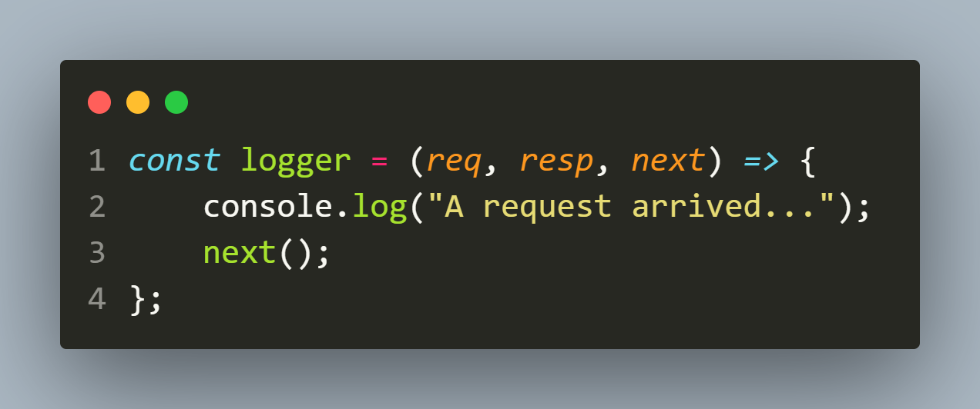
Step-1: Creating middleware

Slide 19
Step-2: using middleware
To make Express load our middleware function we need to call the method use() passing it our function name as argument.
Syntax:
app.use(<name_of_middleware_fn>);
Example:
app.use(logger);

Slide 20
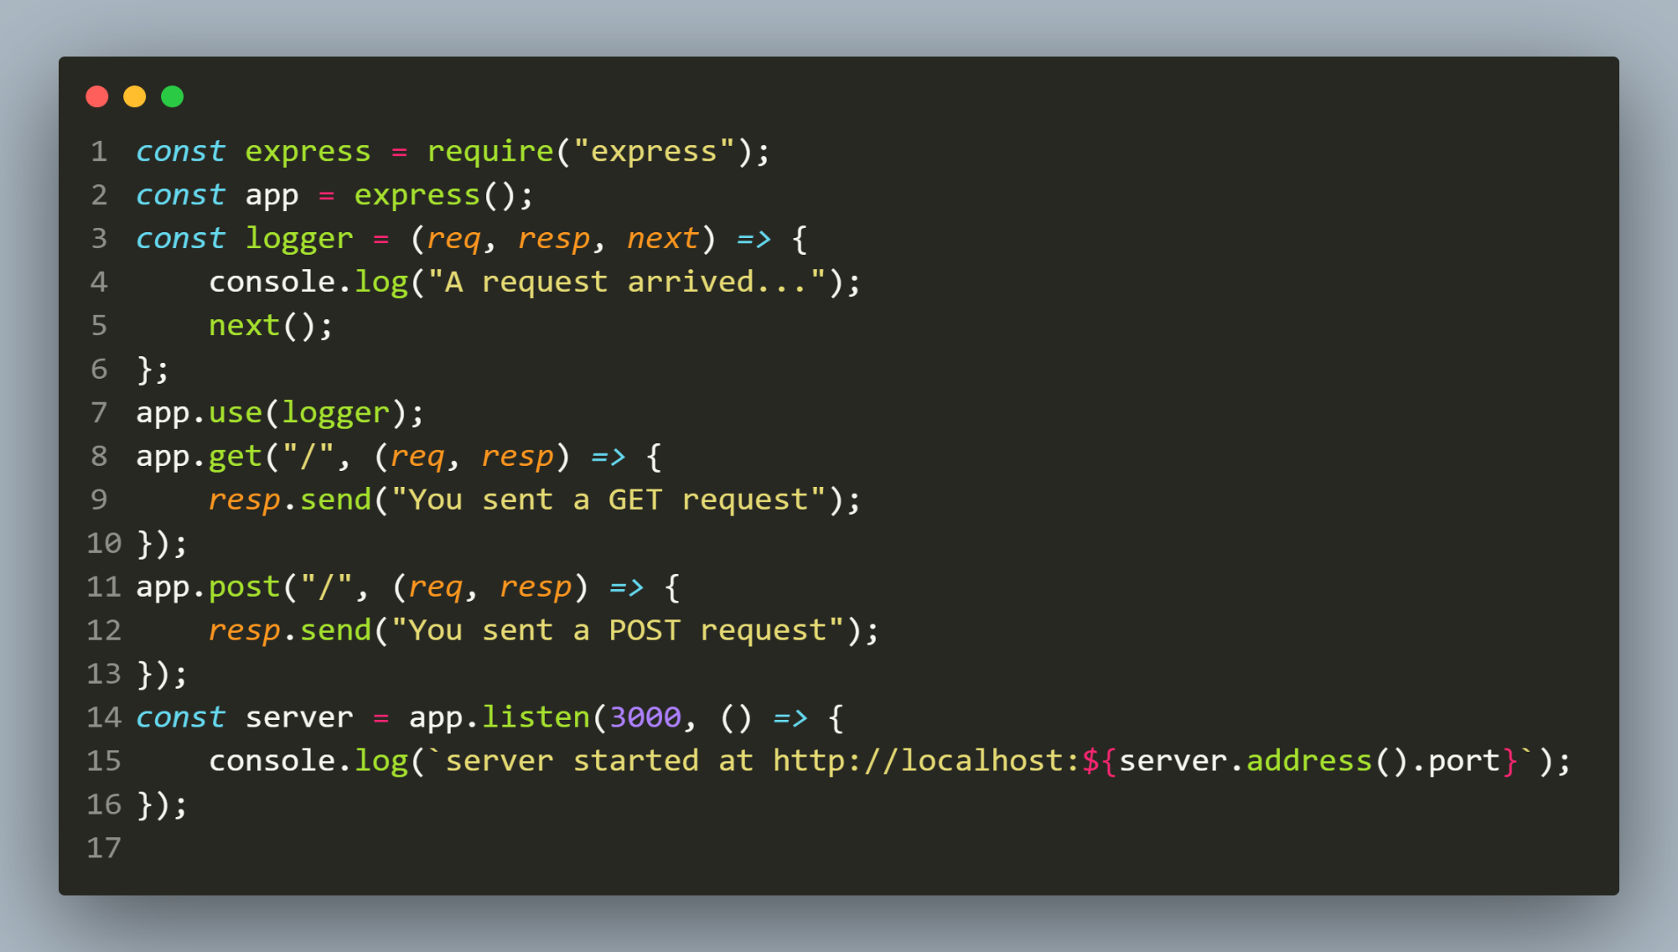
example

Slide 21
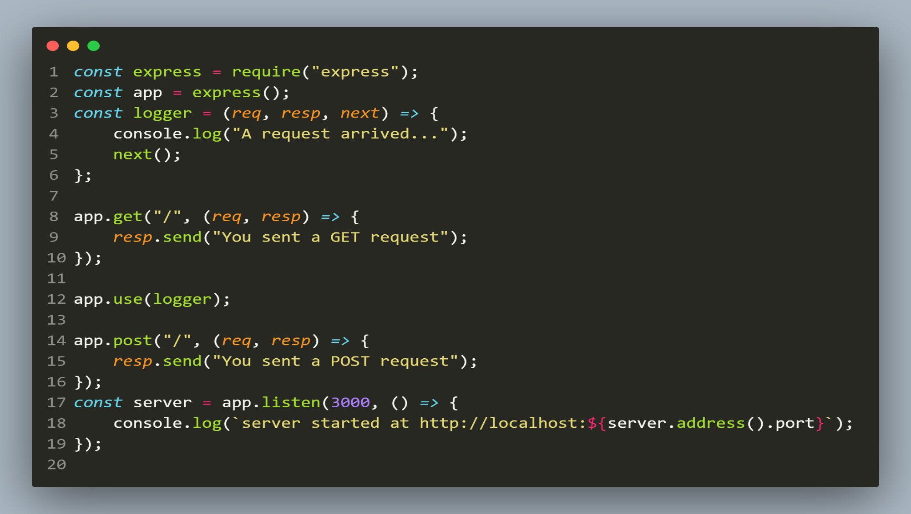
Guess the output !

Slide 22
output
If GET request arrives , middleware will not execute.
If POST request arrives , the middleware will run .
Conclusion:
The order of middleware loading is important.
Middleware functions that are loaded first are also executed first.
Since logger function was loaded after the route to the root path in GET, the request never reaches it and the app doesn’t print “A request arrived..”, because the route handler of the root path terminates the request-response cycle.

Slide 23
Running multiple middlewares
We can execute more than one middleware function, one after the other, on incoming request.
To do this we need to take 3 steps:
Define all the middleware functions
Call next() in them to pass the control to the next middleware function
Pass all the middleware functions as argument to the app.use() method

Slide 24
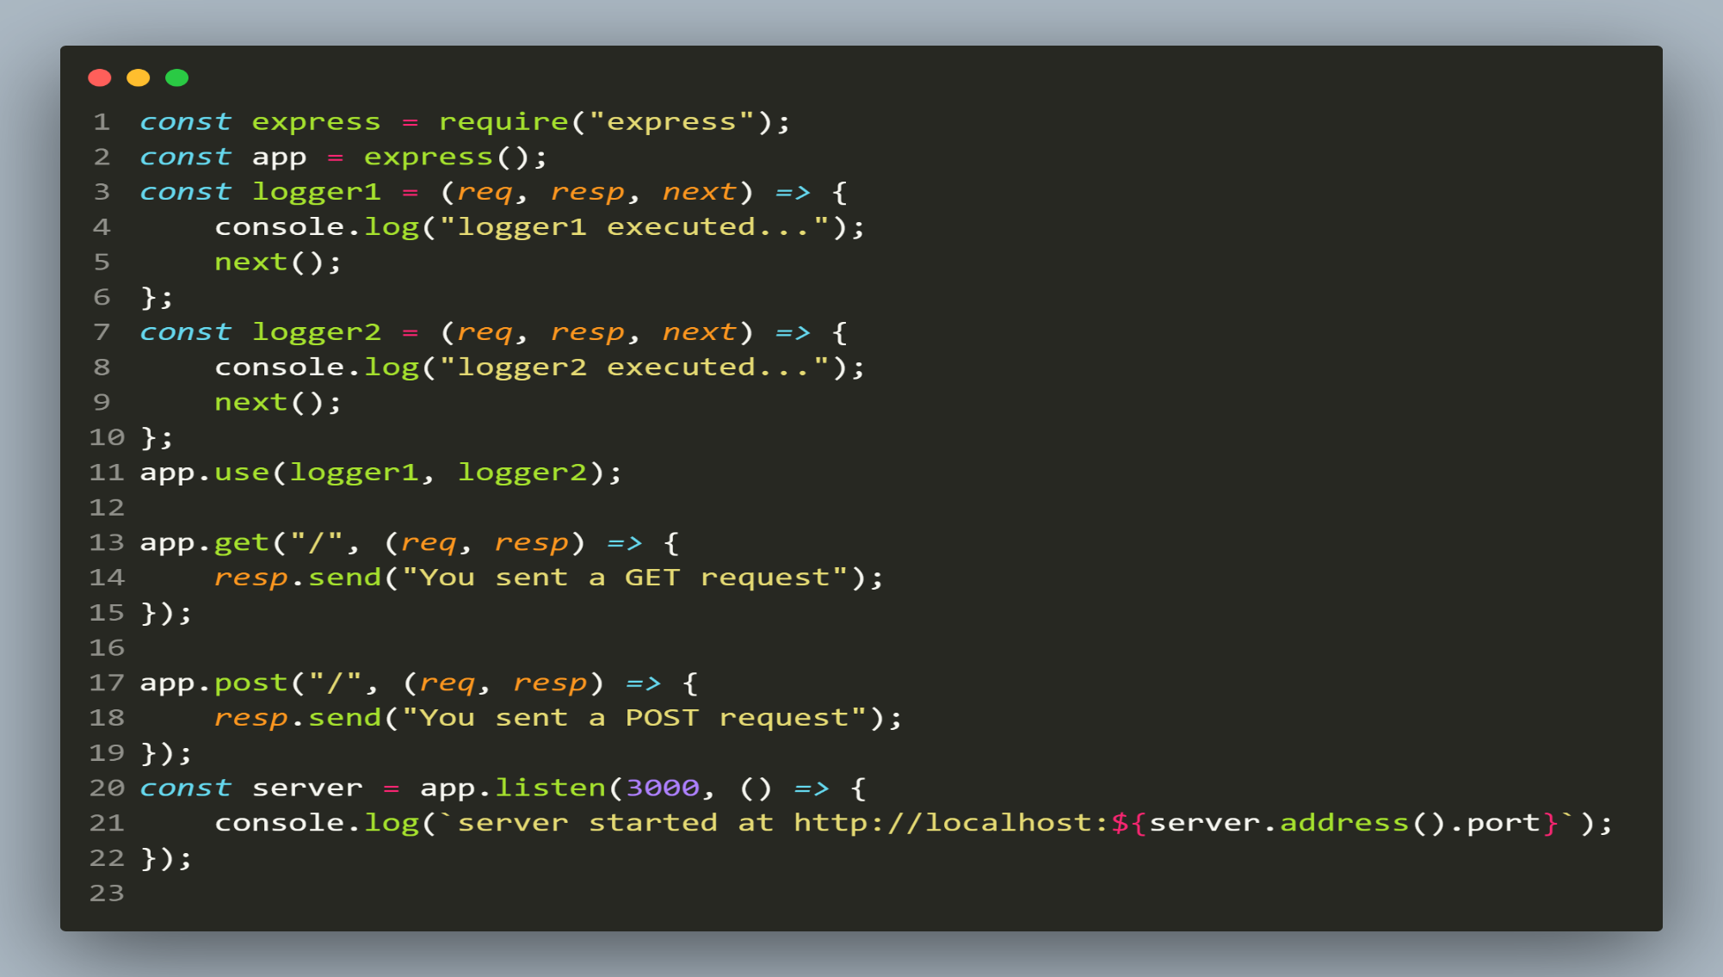
example

Slide 25
Accessing request object
As mentioned previously every middleware has access to the request and response objects.
So it can use the request object properties to gain some more information about the incoming request .

Slide 26
Exercise 49
Write a middleware function to display the request type and the requested URL on console as soon as any request arrives.

Slide 27
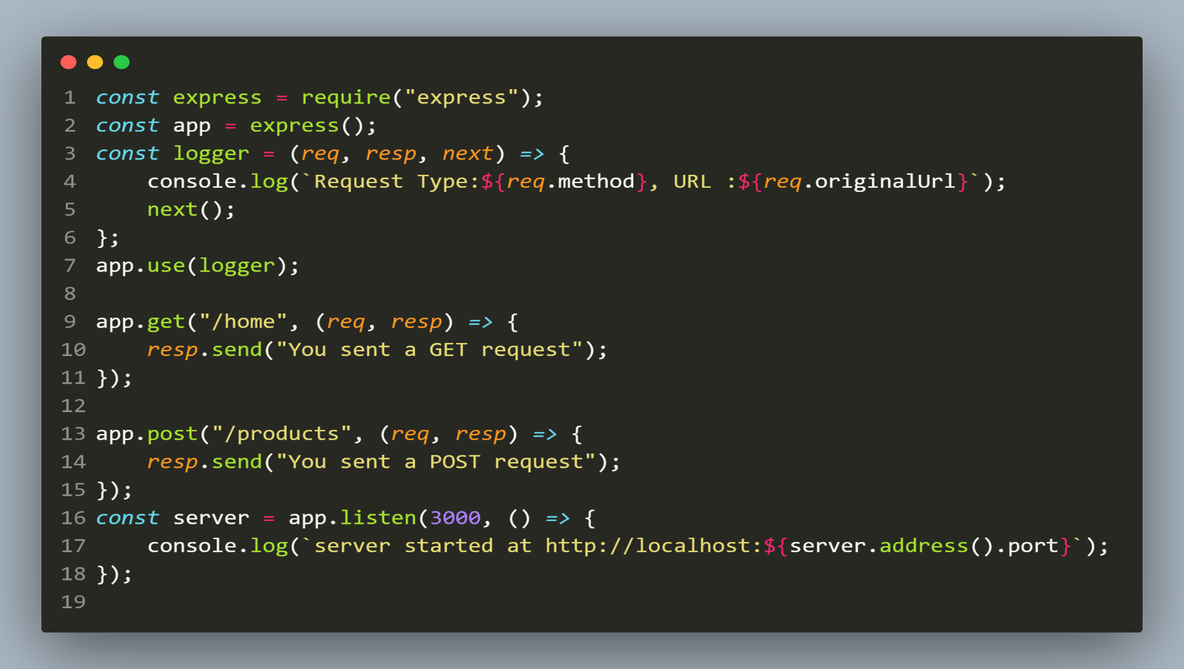
solution

Slide 28
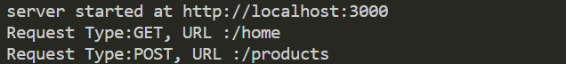
output

Slide 29
Passing data from middleware
Express allows us to modify the request and response objects in middleware function.
For example , we can add a property in request object to pass some data to the next middleware or route handler function .

Slide 30
Exercise 50
Write a middleware function to add a timestamp to the request object as soon as any request arrives.
Finally in GET and POST routes to send back a JSON object to the client containing a message property showing the request type and timestamp .

Slide 31
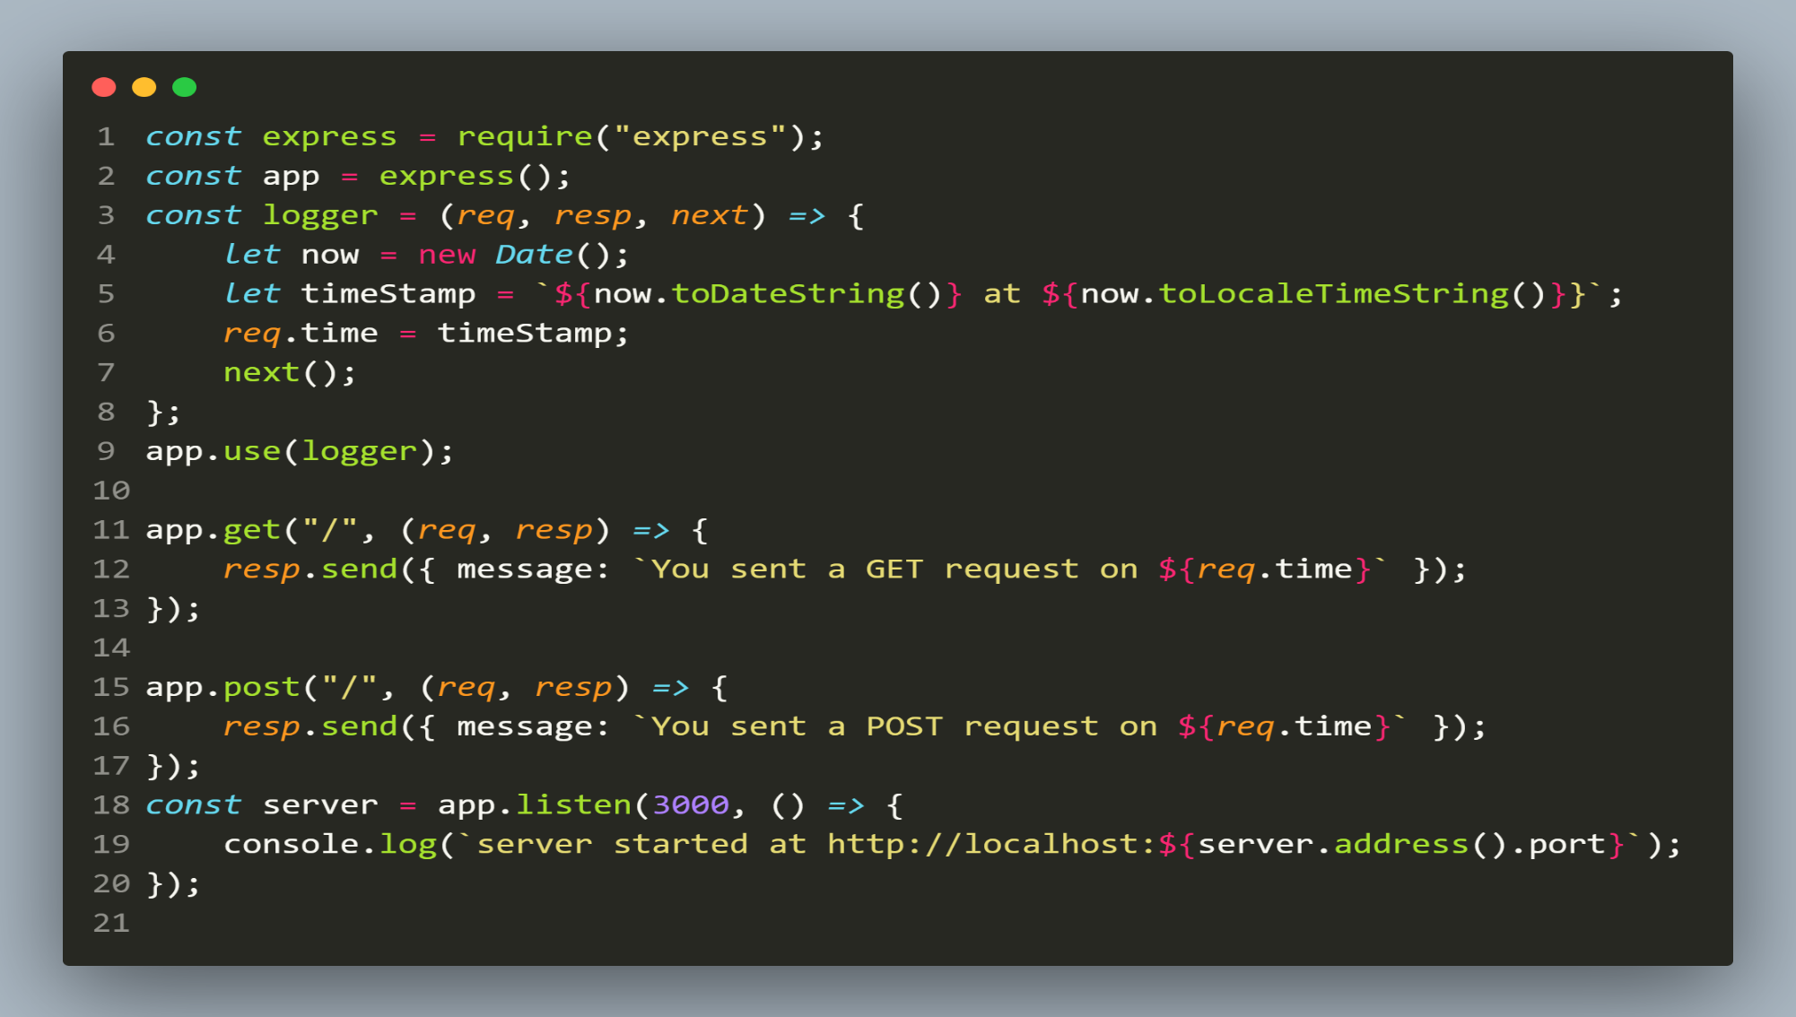
solution

Slide 32
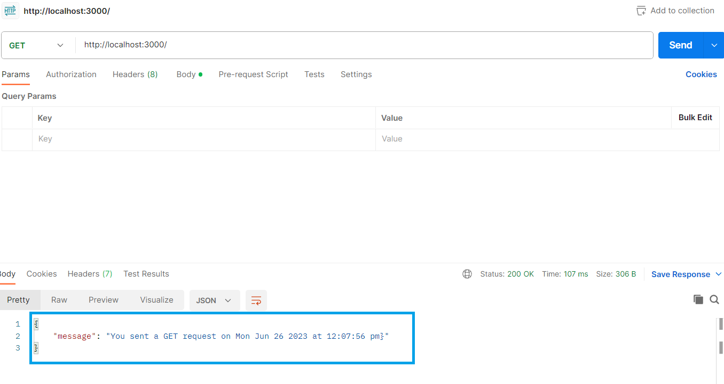
output

Slide 33
Run middleware for a specific route
We can execute an Express middleware only for a specific route.
To do this we pass a route argument before the middleware function to the app.use() method.
Syntax:
app.use(“<route>”, <name_of_middleware_fn>);

Slide 34
Exercise 51
Write 2 middleware functions called logger1 and logger2 so that:
logger1 executes for every route .
logger2 only executes when route is for “/products”

Slide 35
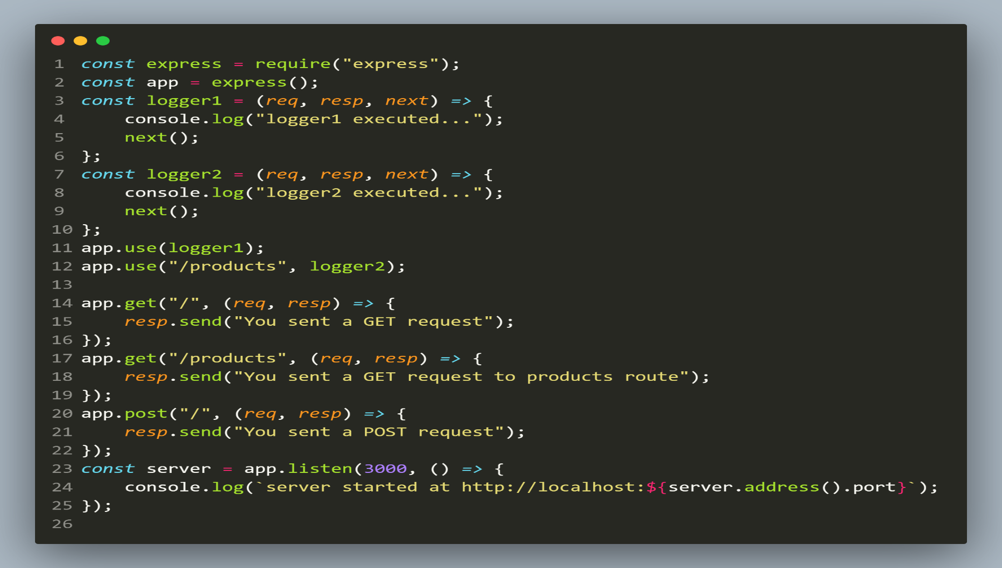
solution

Slide 36
Run middleware for a specific http method
When we pass the middleware function to app.use() method then it runs for EVERY HTTP METHOD .
However we can execute an Express middleware only for a specific HTTP method also.
To do this we pass the middleware function to that method’s route handler instead of use() method
Syntax:
app.<method>(“<route>”, <name_of_middleware_fn>,<callback>);

Slide 37
Exercise 52
Write a middleware functions called logger that runs only for GET request.

Slide 38
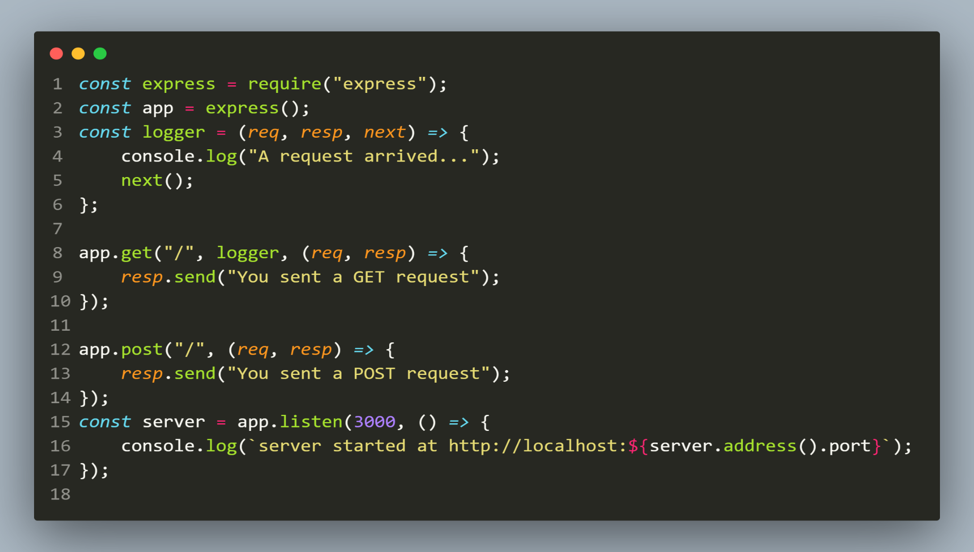
solution

Slide 39
Exercise 53
Write a middleware functions called checkForJson that runs only for POST request and checks whether the request has JSON data or not .
If not , then it should terminate the request by sending status code 400 and the error message that server requires JSON object for POST
Special Note:
We can access all the HTTP headers using the request.headers property

Slide 40
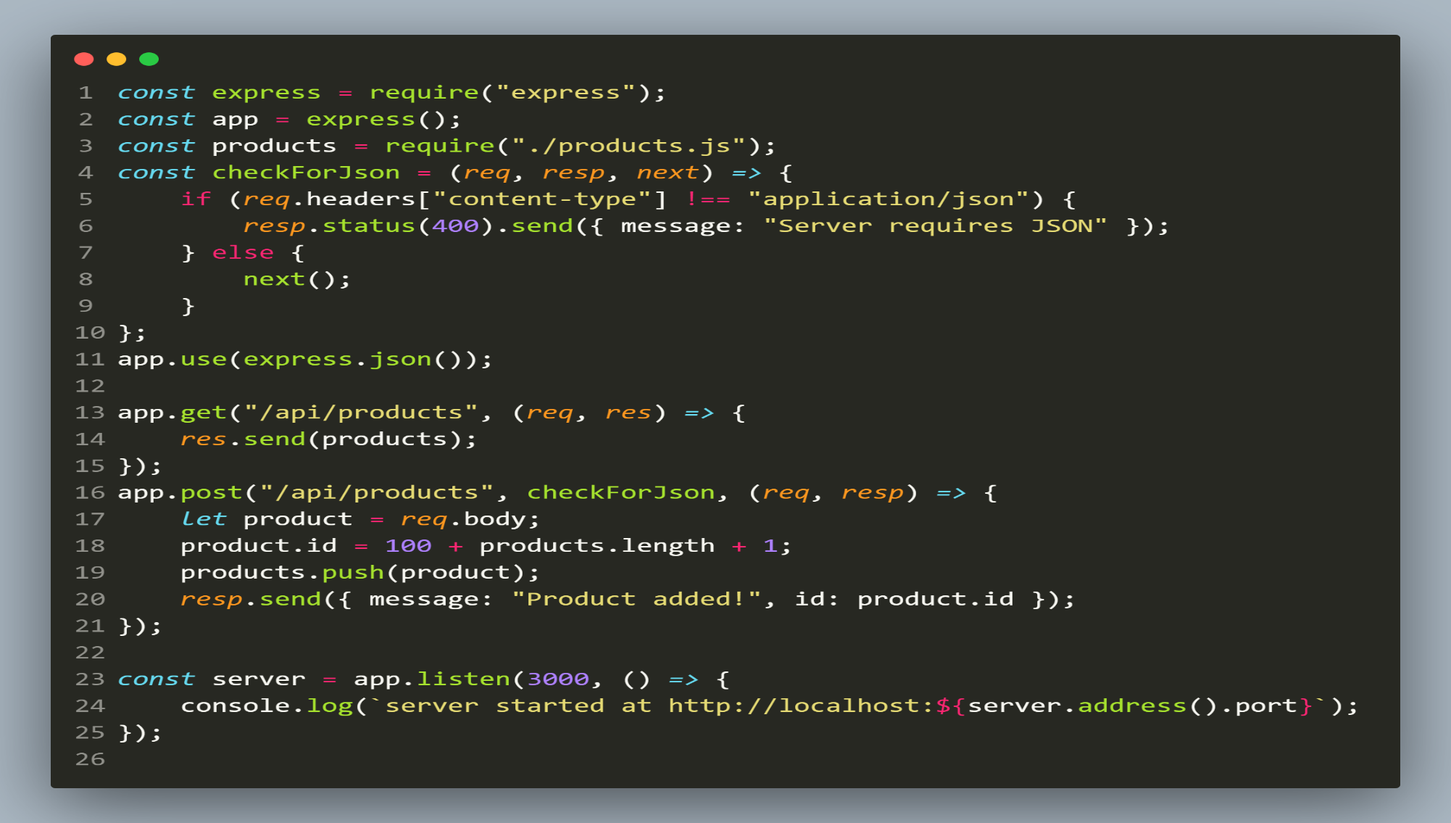
solution

Slide 41
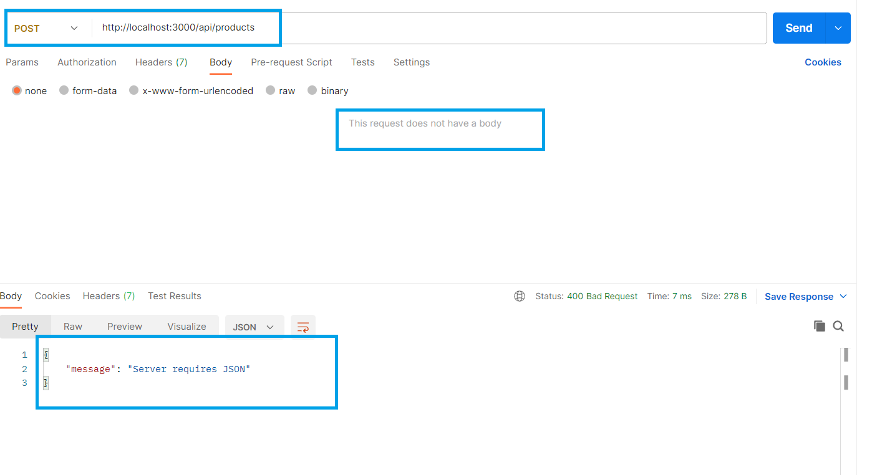
output

Slide 42
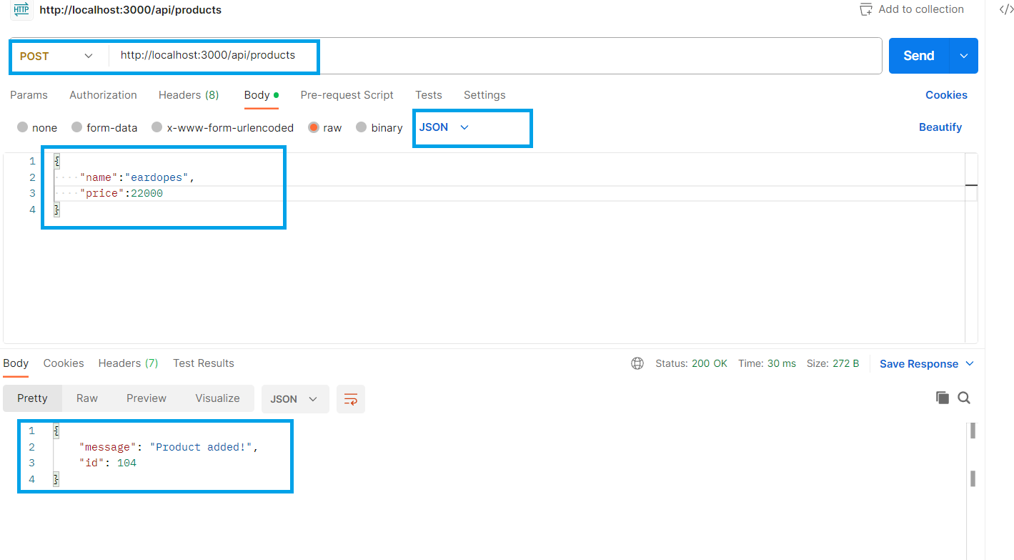
output

Slide 43
Exercise 54
Write 2 middleware functions called protected() and isAdmin() that run only for POST and DELETE requests.
The protected() middleware should check whether user is logged in or not .
If not , then it should send an error message You are not logged in and terminate the request.
The isAdmin() middleware should check whether user is admin or not .
If not , then it should send an error message You are not admin and terminate the request.
Special Note:
Use dummy data for validating logged in and admin

Slide 44
THIRD PARTY MIDDLEWARE
Third party middleware functions are used to enhance the functionality of Express.
Express uses several types of third party middleware functions like “morgan”, “helmet”, “body-parser” etc
In this section, we are going to discuss about “morgan” and “helmet”.

Slide 45
What is morgan ?
Morgan is an HTTP request logger middleware for Node.js typically used for Express apps.
It streamlines the process by generating logs for each API request and error.
The best fact is that we can decide the format of the log which can either be a predefined format or our own format.

Slide 46
Installing morgan
We can install the morgan by using the following command inside our application folder:
npm install –D morgan
What is –D ?
-D is a flag that indicates that we want to install this package as a dev-dependency .

Slide 47
What is a dev-dependency ?
We know that the file package.json contains all the details regarding dependencies of a project and there are three types of dependencies that are found in this file.
They are :
dependencies
dev dependencies
peer dependencies

Slide 48
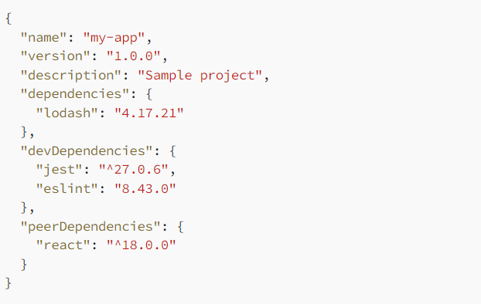
A sample package.json file

Slide 49
dependencies
Dependencies or Regular dependencies or Production dependencies, are the packages that our project relies on to run in a production environment.
These dependencies are essential for the functionality of our JavaScript application and are listed in the “dependencies” section of a package.json file.

Slide 50
dependencies
When we install an npm package using the following command
npm install <package_name>
without any flags, it gets automatically added to the regular dependencies specified in the package.json file.

Slide 51
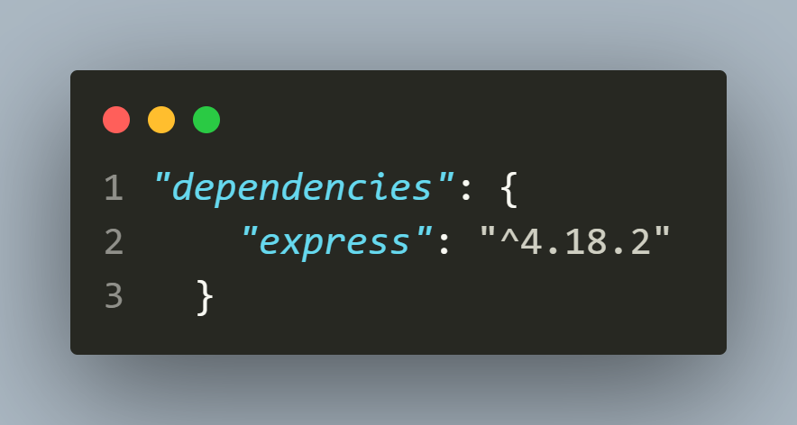
dependencies
For example, npm install express results in Express being added to the dependencies field of the package.json file:

Slide 52
Dev-dependencies
Dev dependencies, short for development dependencies, are packages that are only needed during the development and testing phase of our project.
This means that these dependencies are not strictly required to run our application in a production environment.

Slide 53
Dev-dependencies
Examples of dev dependencies include testing frameworks, code linters, loggers etc.
Dev dependencies are listed in the “devDependencies” section of a package.json file.
To install a dev dependency, we need to specify it using --save-dev or -D flag in the npm install command.

Slide 54
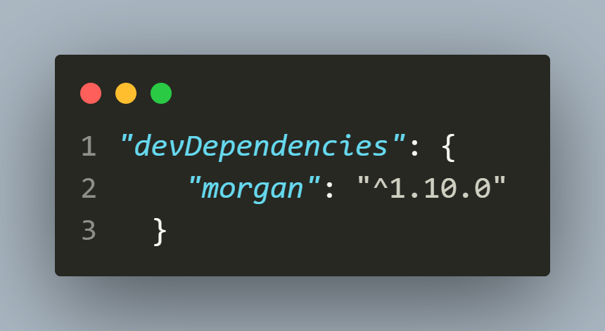
DEV-dependencies
For example, npm install -D morgan results in Morgan being added to the devDependencies field of the package.json file:

Slide 55
peer-dependencies
PeerDependencies are the packages that your package expects to be installed in the user’s environment.
These packages are not installed automatically when your package is installed, but the user is expected to install them manually.

Slide 56
peer-dependencies
The best example of a peer-dependency is ‘react’ which is common in every project to run similarly.
For example, suppose we created a React functional component called FancyButton.
Now , if anyone uses this component then we would expect that his environment must have atleast React 16.8

Slide 57
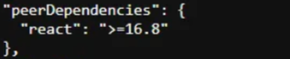
peer-dependencies
PeerDependencies are specified in the peerDependencies section of the package.json file.
For example:

Slide 58
using morgan
To use morgan in our Express server, we take 3 steps:
Load it using require()
This will return a function .
Call that function passing it a format as argument .
Receive the return value and pass it as argument to app.use() before our HTTP requests.

Slide 59
What formats can we pass ?
morgan comes with a suite of predefined format strings, to create a new logger middleware with built-in format and options.
Some popular formats are:
“tiny” : Returns method url status res[content-length] response-time[ms]
Example:

Slide 60
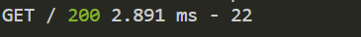
What formats can we pass ?
“short” :Returns remote-addr remote-user method url http-version status res[content-length] response-time[ms]
Example:
“dev” :Returns method url http-version status res[content-length] response-time[ms]
Example:

Slide 61
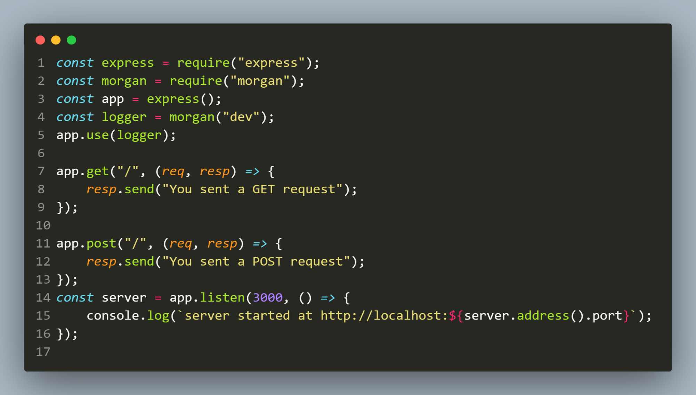
Example

Slide 62
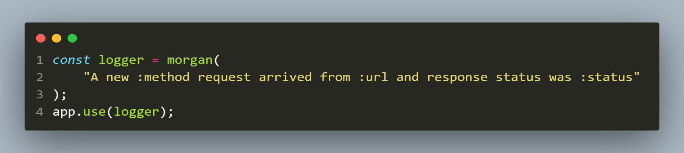
Customizing the predefined formats
morgan allows us to pass our own string as argument with placeholders like :method , :url, :status to fill log with acutal data
Sample Code:
Output

Slide 63
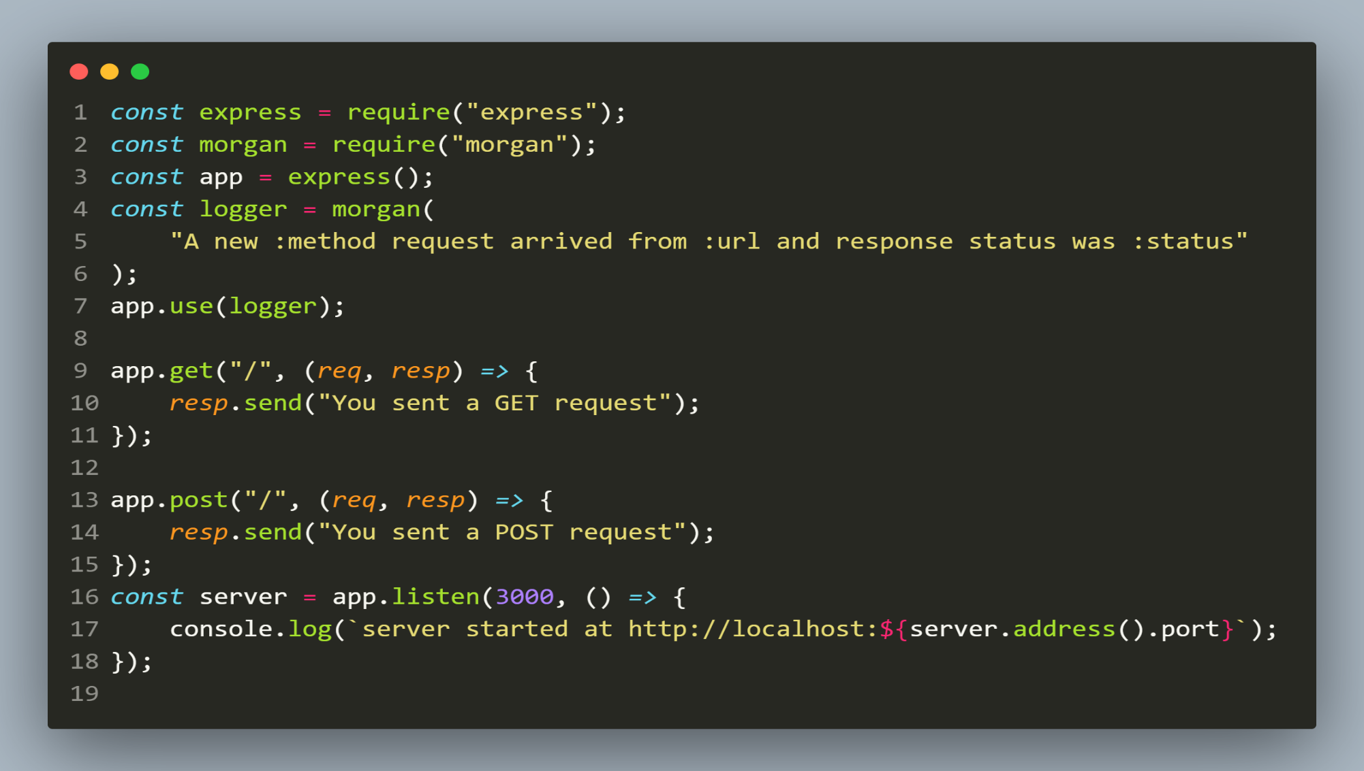
Example

Slide 64
What is helmet ?
Helmet is a middleware that helps us secure our Node.js application by setting several HTTP headers.
It helps to protect Node.js/Express apps from common security threats such as Cross-Site Scripting (XSS) and click-jacking attacks.
Helmet is particularly useful because Express applications do not come with security HTTP headers out of the box.

Slide 65
Installing & Using helmet
We can install the helmet by using the following command inside our application folder:
npm install helmet
To use helmet we can simply load it , then invoke an instance and pass it as an argument in the .use() method call before our HTTP requests.

Slide 66
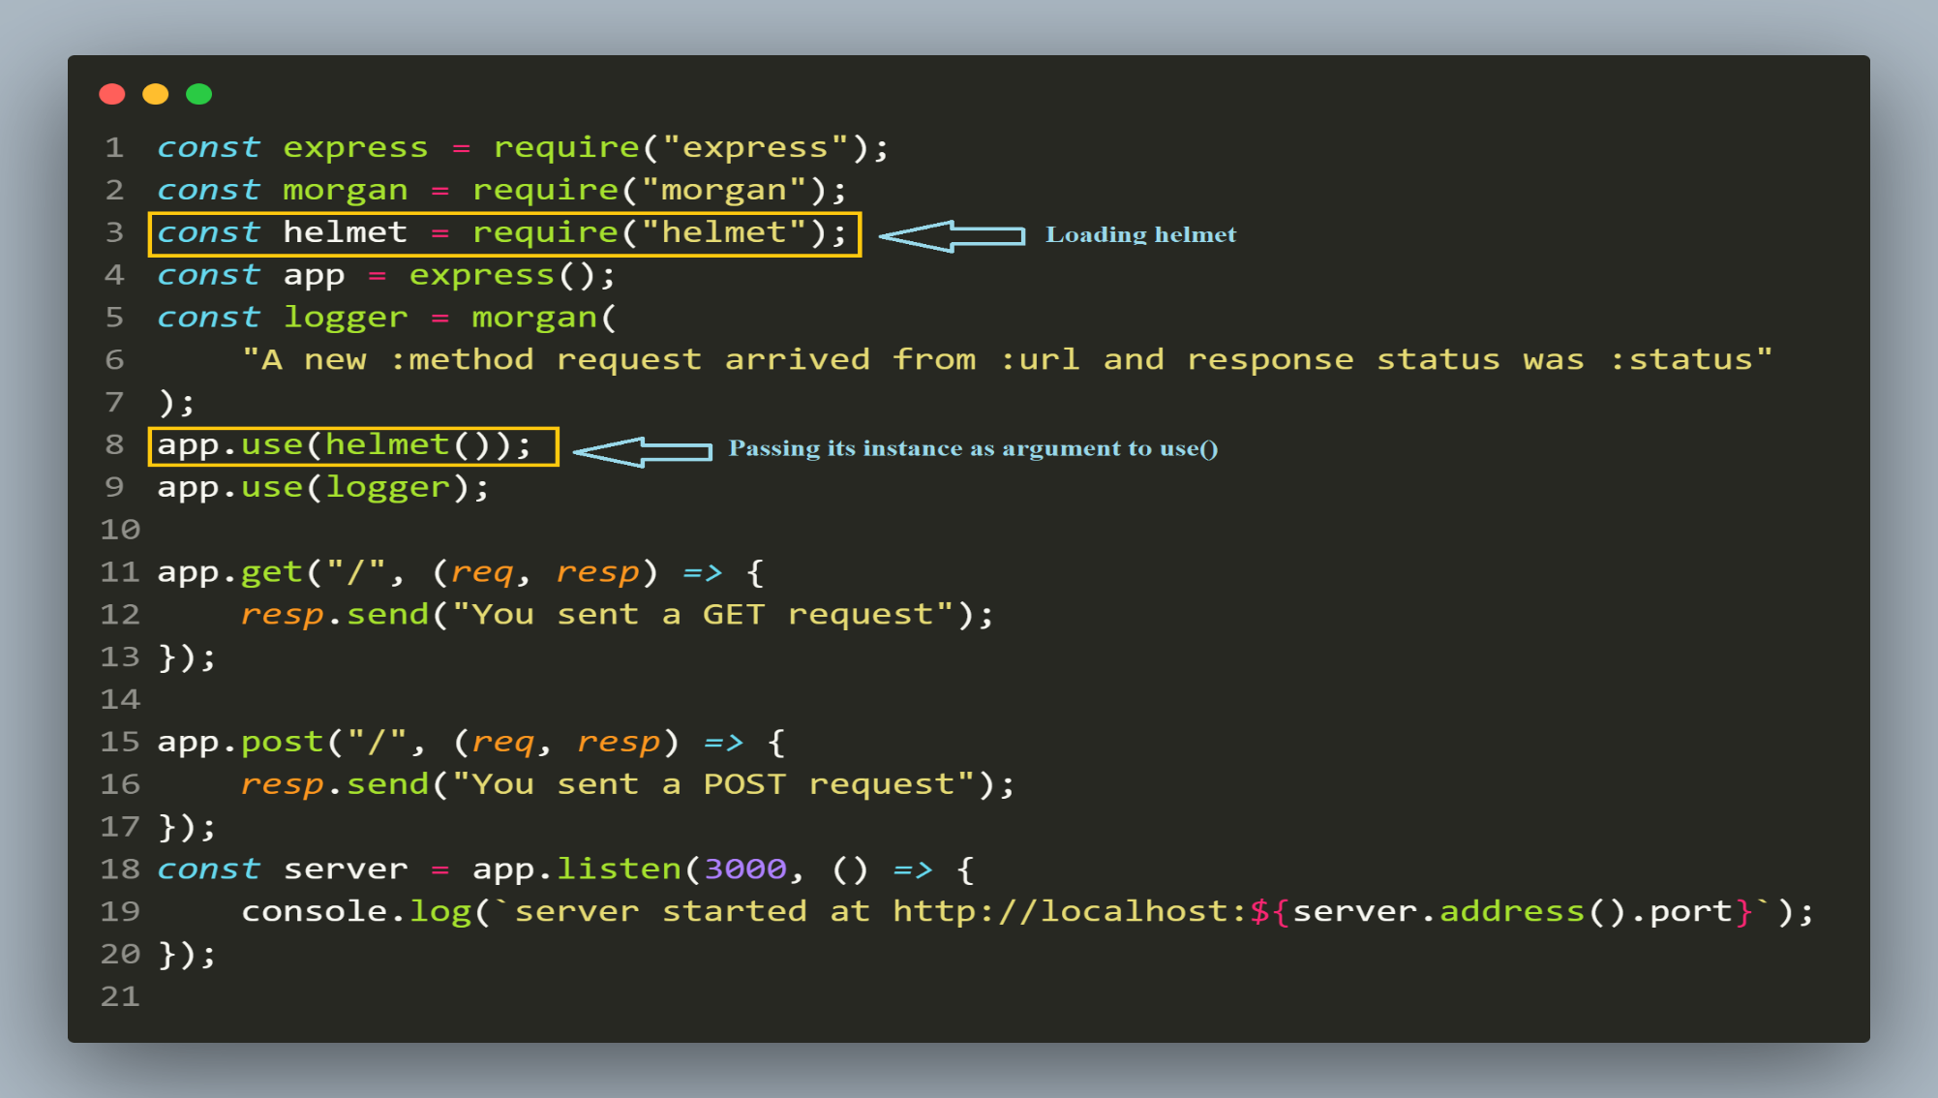
Example

